Slide 1
Introduction to Finite Automata
Languages
Deterministic Finite Automata
Representations of Automata

Slide 2
Alphabets
An alphabet is any finite set of symbols.
Examples: ASCII, Unicode, {0,1} (binary alphabet ), {a,b,c}.

Slide 3
Strings
The set of strings over an alphabet Σ is the set of lists, each element of which is a member of Σ.
Strings shown with no commas, e.g., abc.
Σ* denotes this set of strings.
ε stands for the empty string (string of length 0).

Slide 4
Example: Strings
{0,1}* = {ε, 0, 1, 00, 01, 10, 11, 000, 001, . . . }
Subtlety: 0 as a string, 0 as a symbol look the same.
Context determines the type.

Slide 5
Languages
A language is a subset of Σ* for some alphabet Σ.
Example: The set of strings of 0’s and 1’s with no two consecutive 1’s.
L = {ε, 0, 1, 00, 01, 10, 000, 001, 010, 100, 101, 0000, 0001, 0010, 0100, 0101, 1000, 1001, 1010, . . . }
Hmm… 1 of length 0, 2 of length 1, 3, of length 2, 5 of length
3, 8 of length 4. I wonder how many of length 5?

Slide 6
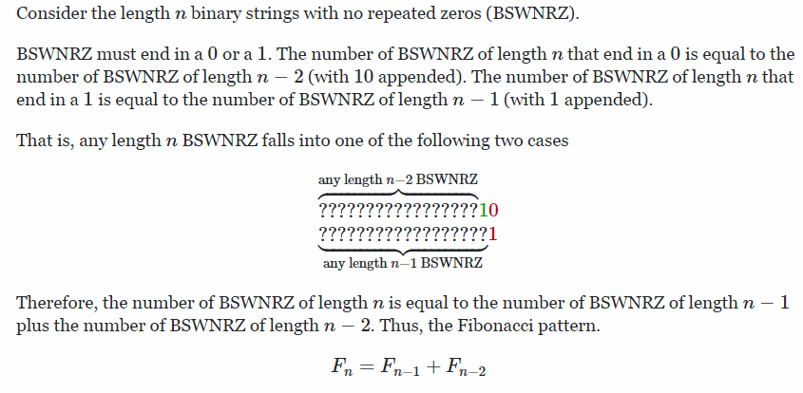
The number of n-length binary strings with no repeated zeros(= or no repeated ones)

Slide 7
Deterministic Finite Automata
A formalism for defining languages, consisting of:
A finite set of states (Q, typically).
An input alphabet (Σ, typically).
A transition function (δ, typically).
A start state (q₀, in Q, typically).
A set of final states (F ⊆ Q, typically).
“Final” and “accepting” are synonyms.

Slide 8
The Transition Function
Takes two arguments: a state and an input symbol.
δ(q, a) = the state that the DFA goes to when it is in state q and input a is received.

Slide 9
Graph Representation of DFA’s
Nodes = states.
Arcs represent transition function.
Arc from state p to state q labeled by all those input symbols that have transitions from p to q.
Arrow labeled “Start” to the start state.
Final states indicated by double circles.

Slide 10
Example: Graph of a DFA
Accepts all strings without two consecutive 1’s.
0
0,1
1
1
A
B
C
Start
0
Consecutive
1’s have
been seen.
Clearly these are the only possibilities!
Previous
string OK,
does not
end in 1.
Previous
String OK,
ends in a
single 1.

Slide 11
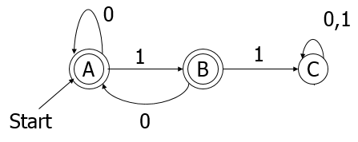
Alternative Representation: Transition Table
Final states
starred
Columns =
input symbols
0
1
*
A A B
B A C
C C C
Arrow for
start state
*
Rows = states

Slide 12
Extended Transition Function
We describe the effect of a string of inputs on a DFA by extending δ to a state and a string.
Induction on length of string.
Basis: δ(q, ε) = q
Induction: δ(q,wa) = δ(δ(q,w),a)
w is a string; a is an input symbol.

Slide 13
Extended δ: Intuition
Convention:
… w, x, y, x are strings.
a, b, c,… are single symbols.
Extended δ is computed for state q and inputs a₁a₂…a_{n} by following a path in the transition graph, starting at q and selecting the arcs with labels a₁, a₂,…,a_{n} in turn.

Slide 14
Example: Extended Delta
0
1
A A B
B A C
C C C
δ(B,011) = δ(δ(B,01),1) = δ(δ(δ(B,0),1),1) =
δ(δ(A,1),1) = δ(B,1) = C

Slide 15
Delta-hat
In book, the extended δ has a “hat” to distinguish it from δ itself (here we used δ).
Not needed, because both agree when the string is a single symbol.
δ(q, a) = δ(δ(q, ε), a) = δ(q, a)
Extended deltas

Slide 16
Language of a DFA
Automata of all kinds define languages.
If A is an automaton, L(A) is its language.
For a DFA A, L(A) is the set of strings labeling paths from the start state to a final state.
Formally: L(A) = the set of strings w such that δ(q₀, w) is in F.

Slide 17
Example: String in a Language
String 101 is in the language of the DFA below.
Start at A.
0
0,1
1
1
A
B
C
Start
0

Slide 18
Example: String in a Language
String 101 is in the language of the DFA below.
Follow arc labeled 1.
0
0,1
1
1
A
B
C
Start
0

Slide 19
Example: String in a Language
String 101 is in the language of the DFA below.
Then arc labeled 0 from current state B.
0
0,1
1
1
A
B
C
Start
0

Slide 20
Example: String in a Language
String 101 is in the language of the DFA below.
Finally arc labeled 1 from current state A. Result
is an accepting state, so 101 is in the language.
0
0,1
1
1
A
B
C
Start
0

Slide 21
Example – Concluded
The language of our example DFA is:
{w | w is in {0,1}* and w does not have
two consecutive 1’s}
Such that…
These conditions
about w are true.
Read a set former as
“The set of strings w…

Slide 22
Proofs of Set Equivalence
Often, we need to prove that two descriptions of sets are in fact the same set.
Here, one set is “the language of this DFA,” and the other is “the set of strings of 0’s and 1’s with no consecutive 1’s.”

Slide 23
Proofs – (2)
In general, to prove S=T, we need to prove two parts: S ⊆ T and T ⊆ S. That is:
If w is in S, then w is in T.
If w is in T, then w is in S.
As an example, let S = the language of our running DFA, and T = “no consecutive 1’s.”

Slide 24
Part 1: S ⊆ T
0
0,1
1
1
A
B
C
Start
0
To prove: if w is accepted by the DFA
then w has no consecutive 1’s.
Proof is an induction on length of w.
Important trick: Expand the inductive hypothesis to be more detailed than you need.

Slide 25
The Inductive Hypothesis
0
0,1
A
1
B
1
C
Start
0
If δ(A, w) = A, then w has no consecutive 1’s and ends in 0 (does not end in 1).
If δ(A, w) = B, then w has no consecutive 1’s and ends in a single 1.
Basis: |w| = 0; i.e., w = ε.
(1) holds since ε has no 1’s at all.
(2) holds since δ(A, ε) is not B.
Important concept:
If the “if” part of “if..then” is false,
the statement is true.
“length of”

Slide 26
Inductive Step
0
0,1
1
1
A
B
C
Start
0
Assume (1) and (2) are true for strings shorter than w, where |w| is at least 1.
Because w is not empty, we can write w = xa, where a is the last symbol of w, and x is the string that precedes.
IH (inductive hypothesis) is true for x.

Slide 27
Inductive Step – (2)
0
0,1
1
1
A
B
C
Start
0
Need to prove (1) and (2) for w = xa.
(1) for w is: If δ(A, w) = A, then w has no consecutive 1’s and does not end in 1.
Since δ(A, w) = A, δ(A, x) must be A or B, and a must be 0 (look at the DFA).
By the Inductive Hypothesis, x has no 11’s.
Thus, w has no 11’s and does not end in 1.

Slide 28
Inductive Step – (3)
0
0,1
1
1
A
B
C
Start
0
Now, prove (2) for w = xa: If δ(A, w) = B, then w has no 11’s and ends in 1.
Since δ(A, w) = B, δ(A, x) must be A, and a must be 1 (look at the DFA).
By the IH, x has no 11’s and does not end in 1.
Thus, w has no 11’s and ends in 1.

Slide 29
Part 2: T ⊆ S
X
Now, we must prove: if w has no 11’s, then w is accepted by
Contrapositive : If w is not accepted by
then w has 11.
0
0,1
Y
A
1
B
1
C
Start
0
0
0,1
A
1
B
1
C
Key idea: contrapositive
of “if X then Y” is the
equivalent statement
“if not Y then not X.”
Start
0

Slide 30
Using the Contrapositive
0
0,1
A
1
B
1
C
Start
0
Every w gets the DFA to exactly one state.
Simple inductive proof based on:
Every state has exactly one transition on 1, one transition on 0.
The only way w is not accepted is if it gets to C.

Slide 31
Using the Contrapositive – (2)
0
0,1
A
1
B
1
C
Start
0
The only way to get to C [formally: δ(A,w) = C] is if w = x1y, x gets to B, and y is the tail of w that follows what gets to C for the first time.
If δ(A,x) = B then surely x = z1 for some z.
Thus, w = z11y and has 11.

Slide 32
Regular Languages
A language L is regular if it is the language accepted by some DFA.
Note: the DFA must accept only the strings in L, no others.
Some languages are not regular.
Intuitively, regular languages “cannot count” to arbitrarily high integers.

Slide 33
Example: A Nonregular Language
L₁ = {0^{n}1^{n} | n ≥ 1}
Note: a^{i} is conventional for i a’s.
Thus, 0⁴ = 0000, e.g.
Read: “The set of strings consisting of n 0’s followed by n 1’s, such that n is at least 1.
Thus, L₁ = {01, 0011, 000111,…}

Slide 34
Another Example
L₂ = {w | w in {(, )}* and w is balanced }
Note: alphabet consists of the parenthesis symbols ’(’ and ’)’.
Balanced parens are those that can appear in an arithmetic expression.
E.g.: (), ()(), (()), (()()),…

Slide 35
But Many Languages are Regular
Regular Languages can be described in many ways, e.g., regular expressions.
They appear in many contexts and have many useful properties.
Example: the strings that represent floating point numbers in your favorite language is a regular language.

Slide 36
Example: A Regular Language
L₃ = { w | w in {0,1}* and w, viewed as a binary integer is divisible by 23}
The DFA:
23 states, named 0, 1,…,22.
Correspond to the 23 remainders of an integer divided by 23.
Start and only final state is 0.

Slide 37
Transitions of the DFA for L₃
If the binary string w represents integer i, then assume δ(0, w) = i%23. (% is modulo as in C#)
Then w0 (w joined with 0 )represents integer 2i, so we want δ(i%23, 0) =δ(δ(0, w),0)=δ(0, w0)= (2i)%23.
Similarly: w1 represents 2i+1, so we want δ(i%23, 1) = (2i+1)%23.
Example: δ(15,0) = 30%23 = 7; δ(11,1) = 23%23 = 0.
Key idea: design a DFA
by figuring out what
each state needs to
remember about the past.
Notes:
e.g. if w=”101101” is decimal i=45, then delta(0,”101101”)=45%23=22
Since w0=”101101”+”0”=2*45+0, so delta(0,w0)=delta(

Slide 38
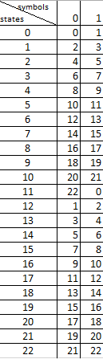


Take the decimal number 46 (divisible by 23) whose binary form is 101110
We’ll end up in final state 0
Take the decimal number 34 (not divisible by 23) whose binary form is 100010
We’ll end up in the non-final state 12

Slide 39
Another Example
L₄ = { w | w in {0,1}* and w, viewed as the reverse of a binary integer is divisible by 23}
Example: 01110100 is in L₄, because its reverse, 00101110 is 46 in binary.
Hard to construct the DFA.
But theorem says the reverse of a regular language is also regular.

Slide 40
The end

